Slide 1
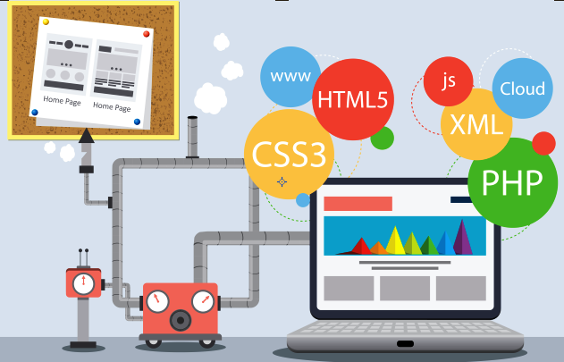
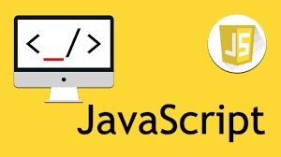
JavaScript Introduction
Web Applications Development
CS381
Module 3:
By Fozia Noor

Slide 2
JavaScript is interactive glue
HTML is for structure
CSS is for style
JavaScript is the interactive glue between HTML and CSS
It is the only programming language a browser can run (without installing any plugins or extensions), and it's a real standard of the Web
In the browser, JavaScript lies between HTML and CSS and will be used together with these two languages.

Slide 3
What IS Javascript

Slide 4
What is JavaScript
JavaScript runs right inside the browser without the need for the JVM.
JavaScript is object oriented, in that almost everything in the language is an object
Conversely, JavaScript is one of the world’s most popular languages, with fewer of the object-oriented features of Java,

Slide 5
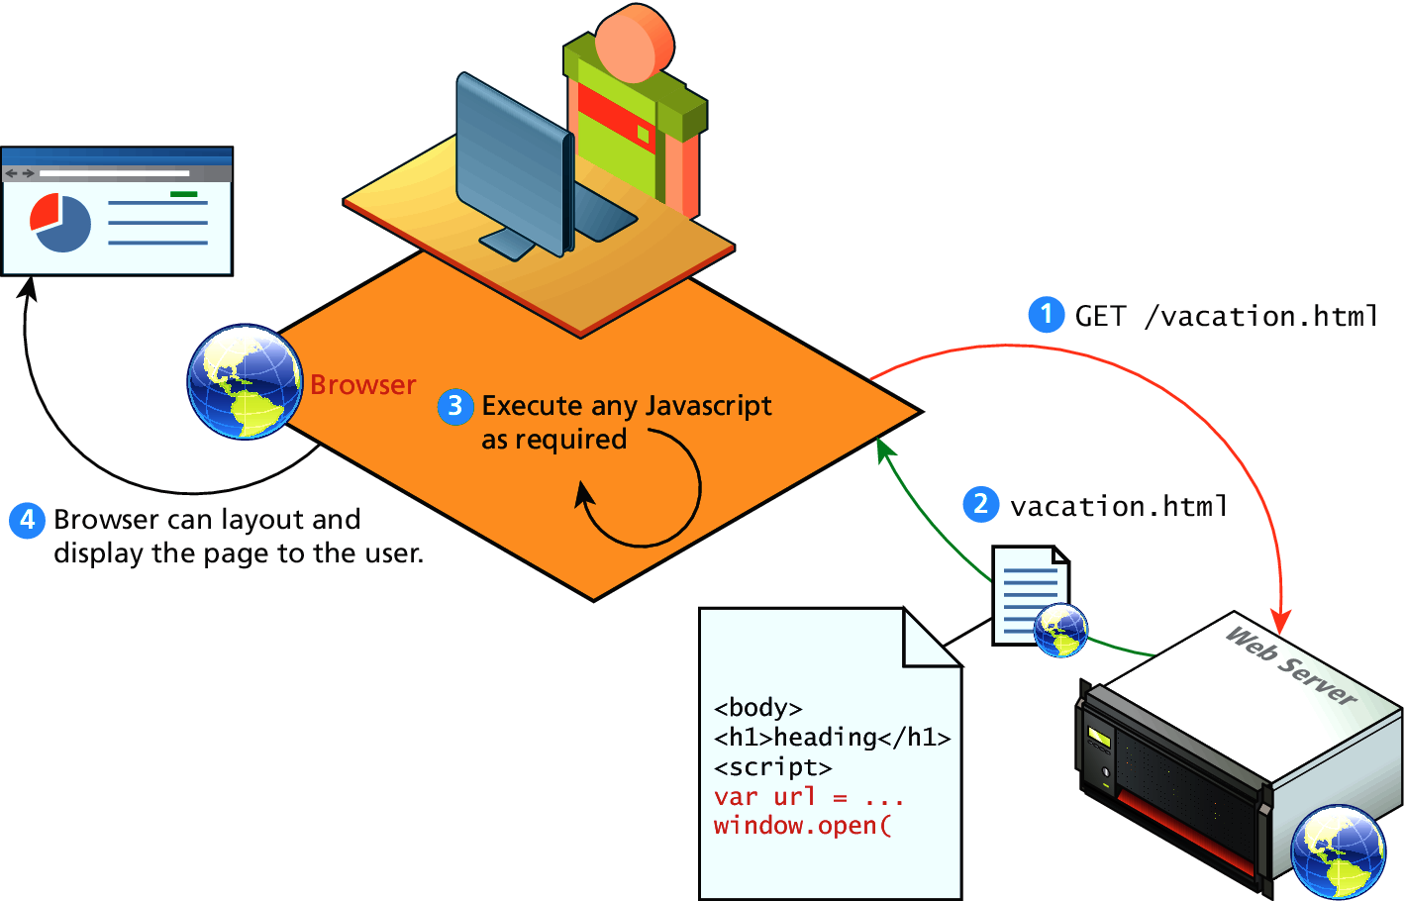
Client-Side Scripting
Let the client compute

Slide 6
Where Does Javascript GO?

Slide 7
Where does JavaScript go?
JavaScript can be linked to an HTML page in a number of ways.
Inline
Embedded
External

Slide 8
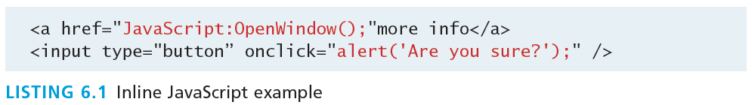
Inline JavaScript
Inline JavaScript refers to the practice of including JavaScript code directly within certain HTML attributes

Slide 9
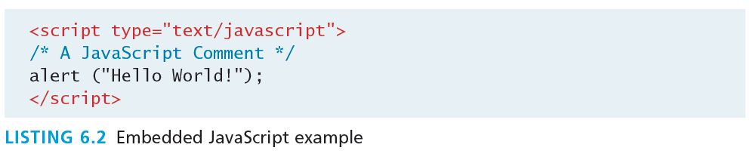
Embedded JavaScript
Embedded JavaScript refers to the practice of placing JavaScript code within a <script> element

Slide 10
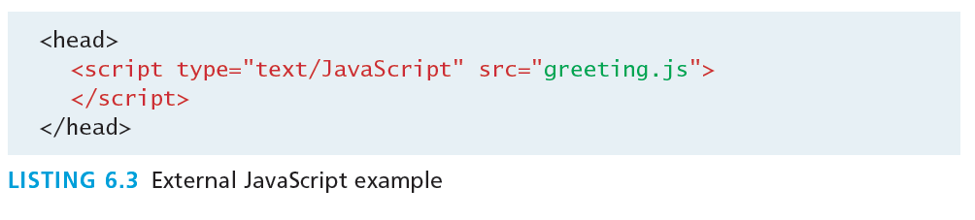
External JavaScript
JavaScript supports this separation by allowing links to an external file that contains the JavaScript.
By convention, JavaScript external files have the extension .js.
If multiple files
<head>
...
<link rel="stylesheet" href="css/style.css">
<script src="js/script1.js"></script>
<script src="js/script2.js"></script>
<script src="js/anotherOne.js"></script>
...
</head

Slide 11
Syntax

Slide 12
JavaScript Syntax
The fundamental syntax for the most common programming constructs including
variables,
assignment,
conditionals,
loops, and
arrays

Slide 13
JavaScript’s Reputation
Everything is type sensitive, including function, class, and variable names.
The scope of variables in blocks is not supported. This means variables declared inside a loop may be accessible outside of the loop.
Semicolons are not required, but are permitted (and encouraged).
There is no integer type, only number.

Slide 14
Variables
Variables in JavaScript are dynamically typed, meaning a variable can be an integer, and then later a string, then later an object, if so desired.
This simplifies variable declarations, so that we do not require the familiar type fields like int, char, and String. Instead we use var/let.
Assignment can happen at declaration-time by appending the value to the declaration, or at run time with a simple right-to-left assignment.
The first letter of a variable can only be "$", "_", "a" to "z", or "A" to "Z".

Slide 15
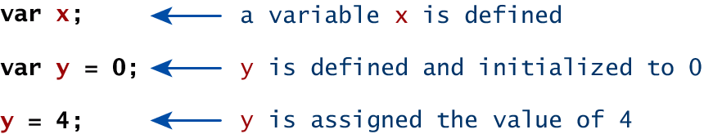
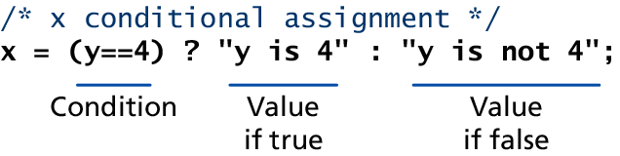
Variables
Assignment

Slide 16
Comparison Operators
True or not True
Operator | Description | Matches (x=9)
== | Equals | (x==9) is true (x=="9") is true
=== | Exactly equals, including type | (x==="9") is false (x===9) is true
< , > | Less than, Greater Than | (x<5) is false
<= , >= | Less than or equal, greater than or equal | (x<=9) is true
!= | Not equal | (4!=x) is true
!== | Not equal in either value or type | (x!=="9") is true (x!==9) is false

Slide 17
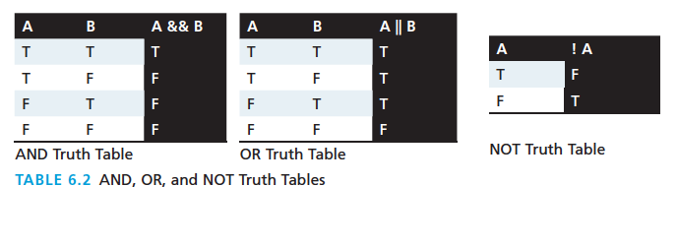
Logical Operators
The Boolean operators and, or, and not and their truth tables are listed. Syntactically they are represented with && (and), || (or), and ! (not).

Slide 18
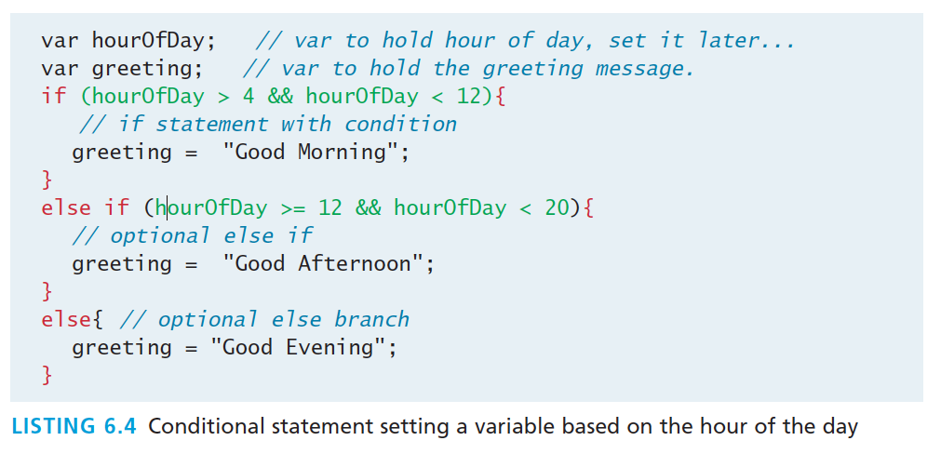
Conditionals
JavaScript’s syntax is almost identical to that of PHP, Java, or C when it comes to conditional structures.

Slide 19
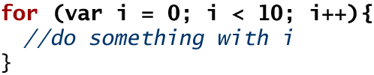
Loops
Like conditionals, loops use the ( ) and { } blocks to define the condition and the body of the loop.
While loops normally initialize a loop control variable before the loop, use it in the condition, and modify it within the loop.
var i=0; // initialise the Loop Control Variable
while(i < 10){ //test the loop control variable
i++; //increment the loop control variable
}

Slide 20
Functions
Functions are the building block for modular code in JavaScript,
They are defined by using the reserved word function and then the function name and (optional) parameters.
Since JavaScript is dynamically typed, functions do not require a return type, nor do the parameters require type.
Therefore a function to raise x to the yth power might be defined as:
function power(x,y){
var pow=1;
for (var i=0;i<y;i++){
pow = pow*x;
}
return pow;
}
And called as
power(2,10);

Slide 21
Alert
The alert() function makes the browser show a pop-up to the user, with whatever is passed being the message displayed.
The following JavaScript code displays a simple hello world message in a pop-up:
alert ( "Good Morning" );
Using alerts can get tedious fast. When using debugger tools in your browser you can write output to a log with:
console.log("Put Messages Here");

Slide 22
Built-in JavaScript class: Number
The Number class can be used to transform strings into numbers
>var n = Number('3.1416');
> n;
3.1416

Slide 23
Javascript Objects

Slide 24
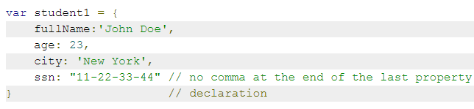
JavaScript Objects
JavaScript is not a full-fledged object-oriented programming language.
It does not support many of the patterns you’d expect from an object-oriented language like inheritance and polymorphism.
The language does, however, support objects.
Objects can have constructors, properties, and methods associated with them.
There are objects that are included in the JavaScript language; you can also define your own kind of objects

Slide 25
Constructors
Normally to create a new object we use the new keyword, the class name, and ( ) brackets with n optional parameters inside, comma delimited as follows:
var someObject = new ObjectName(p1,p2,..., pn);
For some classes, shortcut constructors are defined
var greeting = "Good Morning";
vs the formal:
var greeting = new String("Good Morning");

Slide 26

Properties
Each object might have properties that can be accessed, depending on its definition.
When a property exists, it can be accessed using dot notation where a dot between the instance name and the property references that property.
//show someObject.property to the user alert(someObject.property);

Slide 27
Methods
Objects can also have methods, which are functions associated with an instance of an object.
These methods are called using the same dot notation as for properties, but instead of accessing a variable, we are calling a method.
someObject.doSomething();

Slide 28
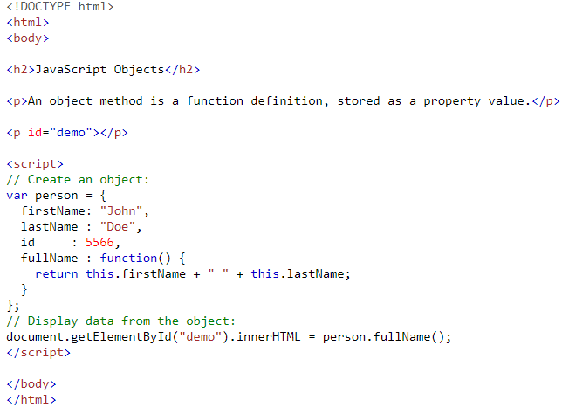
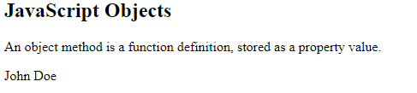
Example

Slide 29
Objects Included in JavaScript
A number of useful objects are included with JavaScript including:
Array
Date
Math
String
Dom objects

Slide 30

Arrays
Arrays are one of the most used data structures.
The following code creates a new, empty array named greetings:
var greetings = new Array();
If only one element, this corresponds to the initial size of the array.
var myArray = new Array(3);
To initialize the array with values, the variable declaration would look like the following:
var greetings = new Array("Good Morning", "Good Afternoon");
or, using the square bracket notation:
var greetings = ["Good Morning", "Good Afternoon"];
You can add elements to an array using a new index or using the push method.

Slide 31
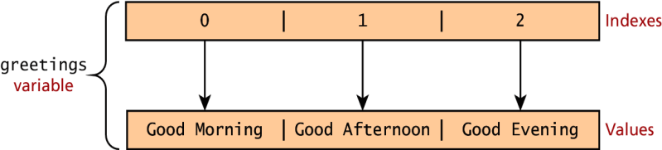
Arrays
To access an element in the array you use the square bracket notation, with the index you wish to access inside the brackets.
alert ( greetings[0] );
One of the most common actions on an array is to traverse through the items sequentially.
Using the Array object’s length property to determine the maximum valid index.
for (var i = 0; i < greetings.length; i++){
alert(greetings[i]);}
The pop method can be used to remove an item from the back of an array.
Additional methods: concat(), slice(), join(), reverse(), shift(), and sort()

Slide 32
Array methods
appends at the end and returns the new length
>var a = [3, 5, 1, 7, 'test'];
>a.push('new')
6
> a;
[3, 5, 1, 7, "test", "new"]
removes the last element and returns it
> a.pop();
"new"
> a;
[3, 5, 1, 7, "test"]
Sort array
> var b = a.sort();
> b;
[1, 3, 5, 7, "test"]
> a;
[1, 3, 5, 7, "test"]
>
Use join
> a.join(' and ');
"1 and 3 and 5 and 7 and test“

Slide 33
Math
The Math class allows one to access common mathematic functions and common values quickly in one place.
This static class contains methods such as max(), min(), pow(), sqrt(), and exp(), and trigonometric functions such as sin(), cos(), and arctan().
Many mathematical constants are defined such as PI and some others
Math.PI; // 3.141592657
Math.sqrt(4); // square root of 4 is 2.
Math.random(); // random number between 0 and 1

Slide 34
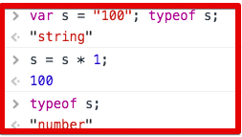
String
The String class has already been used without us even knowing it.
Constructor usage
var greet = new String("Good"); // long form constructor
var greet = "Good"; // shortcut constructor
Length of a string
alert (greet.length); // will display "4“
A String number in an arithmetic expression is converted to Number, unless the formula is a pure addition.
Concatenation
var str = greet.concat("Morning"); // Long form concatenation
var str = greet + "Morning"; // + operator concatenation

Slide 35
Date
The Date class is yet another helpful included object.
To display today’s date as a string, we would simply create a new object and use the toString() method.
var d = new Date();
// This outputs Today is Mon Nov 12 2012 15:40:19 GMT-0700
alert ("Today is "+ d.toString());

